Slide 1
Database Protection

Slide 2
Protection
Operating system consists of a collection of objects, hardware or software.
Each object has a unique name and can be accessed through a well-defined set of operations.
Protection problem - ensure that each object is accessed correctly and only by those transactions/processes that are allowed to do so.

Slide 3
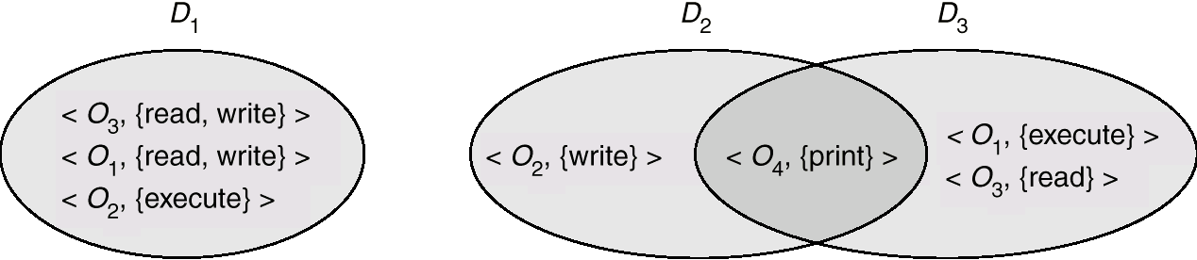
Domain Structure
Access-right = <object-name, rights-set>
where rights-set is a subset of all valid operations that can be performed on the object.
Domain = set of access-rights

Slide 4
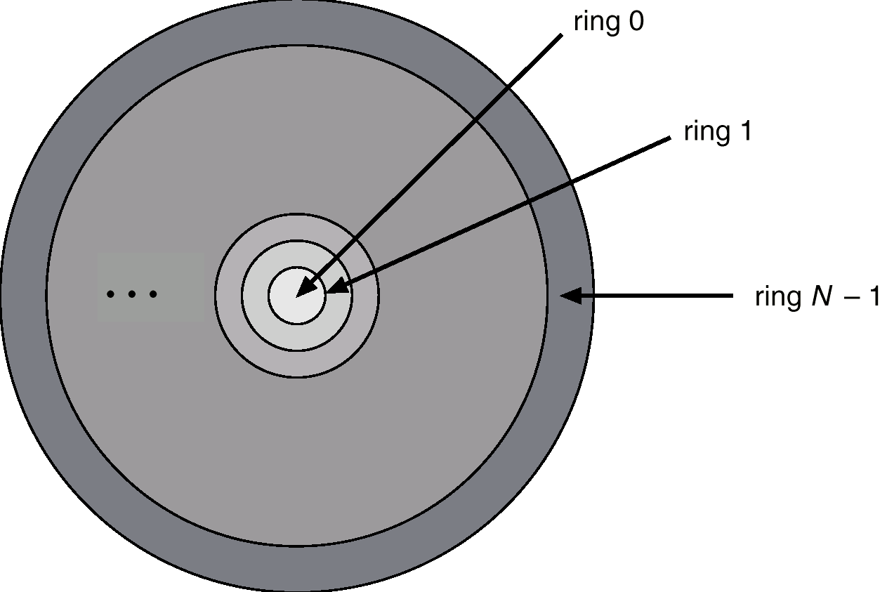
Domain Implementation (Multics)
Let D_{i} and D_{j} be any two domain rings.
If i < j ⇒ D_{i} ⊆ D_{j}
Multics Rings

Slide 5
Access Matrix
View protection as a matrix (access matrix)
Rows represent domains
Columns represent objects
Access(i, j) is the set of operations that a process executing in Domain_{i} can invoke on Object_{j}

Slide 6
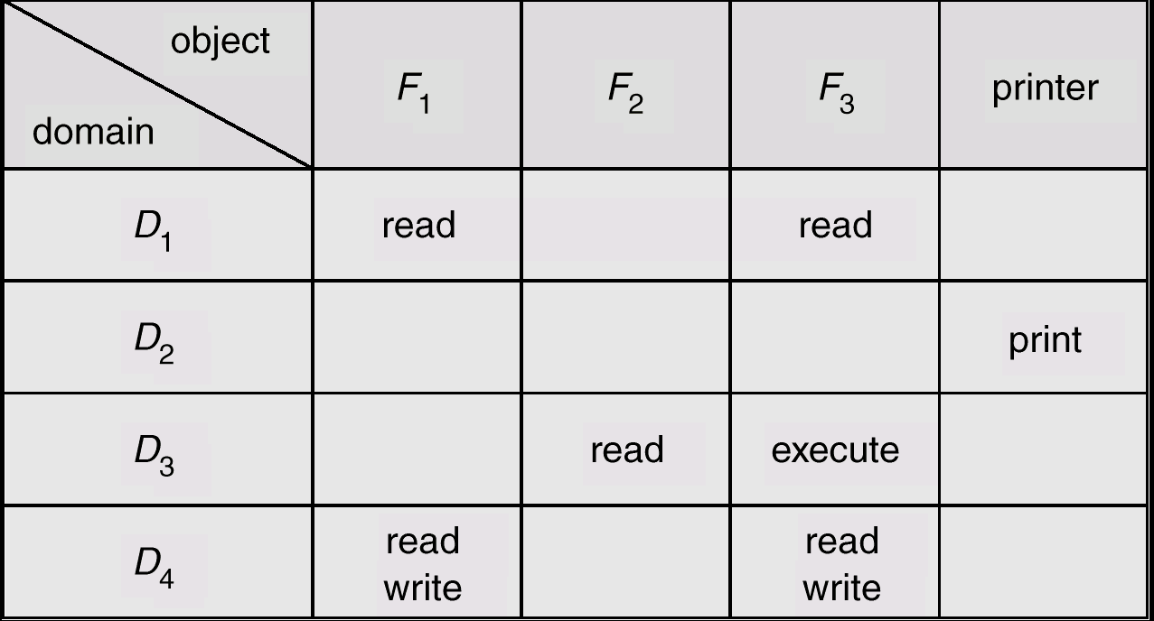
Access Matrix
Figure A

Slide 7
Implementation of Access Matrix
Each column = Access-control list for one object
Defines who can perform what operation.
Domain 1 = Read
Domain 2 = Print
Domain 3 = Read, Execute
Domain 4 = Read, Write
Each Row = Capability List (like a key) for each domain, what operations allowed on what objects.
      Object 1 – Read, Write
      Object 2 – Read
      Object 3 – Read, Write, Execute
      Object 4 – Print

Slide 8
Definition and need for MLS
Multilevel security involves a database in which the data stored has an associated classification and consequently constraints for their access
MLS allows users with different classification levels to get different views from the same data
MLS cannot allow downward leaking, meaning that a user with a lower classification views data stored with a higher classification

Slide 9
Bell – LaPadula Model
Bell-LaPadula model was developed in 1973
This is an extension of the Access Matrix model with classified data
This model has two components:
  Classification
  Set of categories
Bell-LaPadula model shows how to use Mandatory Access Control to prevent the Trojan Horse

Slide 10
Bell – LaPadula Model
  Classification has four values {U, C, S, TS}
    U = unclassified
    C = confidential
    S = secret
    TS = top secret
  Classifications are ordered: TS > S > C > U
  Set of categories consists of the data environment and the application area, i.e., Nuclear, Army, Financial, Research
Example: In USA, a “SECRET” clearance involves checking FBI fingerprint files.

Slide 11
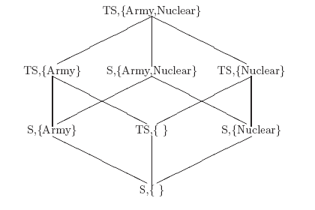
Bell – LaPadula Model
An access class c1 dominates ≥ an access class c2 if
  Security level of c1 is greater than or equal to that of c2
  The categories of c1 include those of c2

Slide 12
Bell – LaPadula Model
Bell-LaPadula model is based on a subject-object paradigm
Subjects are active elements of the system that execute actions
Objects are passive elements of the system that contain information
Subjects act on behalf of users who have a security level associated with them (indicating the level of system trust)

Slide 13
Bell – LaPadula Model Contd…
Subjects execute access modes on objects
Access modes are:
  Read-only
  Append (writing without reading)
  Execute
  Read-write
Decentralized administration of privileges on objects

Slide 14
Bell – LaPadula Model Contd…
Control direct and indirect flows of information
Prevent leakage to unauthorized subjects
User can connect to the system with any access class dominated by their clearance

Slide 15
Bell – LaPadula Model
Two main properties of this model for a secure system are:
  Simple security property
  Star property
Simple security means: A subject may have read or write access to an object only if the clearance of the subject dominates the security level of the object

Slide 16
Bell – LaPadula Model
Star property means: An untrusted subject may:
append if object security dominates subject security
write if object security equals subject security
read if object security is less than subject security
This model guarantees secrecy by preventing unauthorized release of information
This model does not protect from unauthorized modification of information.

Slide 17
Key Points
Confidentiality models restrict flow of information
Bell-LaPadula (BLP) models multilevel security
  Cornerstone of much work in computer security
  Simple security property says no read up and
  Star property says no write down
  Both ensure information can only flow up

Slide 18
Intrusion (unwanted involvement) Detection
Security must consider external environment of the system, and protect it from:
  unauthorized access.
  malicious modification or destruction
  accidental introduction of inconsistency (CHANGE).
Easier to protect against accidental than malicious misuse.

Slide 19
Authentication
User identity established through passwords, can be considered a special case of either keys or capabilities.
Passwords must be kept secret.
  Frequent change of passwords.
  Use of “non-guessable” passwords.
  Log all invalid access attempts.
Passwords may also either be encrypted or allowed to be used only once.

Slide 20
Program Threats
Trojan Horse
  Code segment that misuses its environment.
  Exploits mechanisms for allowing programs written by users to be executed by other users.
Trap Door
  Specific user identifier or password that circumvents (to avoid something) normal security procedures.
  Could be included in a compiler.
Stack and Buffer Overflow
  Exploits a bug in a program (overflow either the stack or memory buffers.)

Slide 21
System Threats
Worms – to cause something new, or many new things, to grow or start suddenly
Internet worm
  bugs in sendmail programs.
  Grappling hook program uploaded main worm program.
Viruses – fragment of code embedded in a legitimate (allowed by law) program.
  Mainly effect microcomputer systems.
  Downloading viral programs from public bulletin boards or exchanging floppy disks or pen drive etc. containing an infection.
Denial of Service
  Overload the targeted computer preventing it from doing any useful work.

Slide 22
Threat Monitoring
Check for suspicious patterns of activity – i.e., several incorrect password attempts may signal password guessing.
Audit log – records the time, user, and type of all accesses to an object; useful for recovery from a violation and developing better security measures.
Scan the system periodically for security holes; done when the computer is relatively unused.

Slide 23
Check for:
  Short or easy-to-guess passwords
  Unauthorized set-uid programs
  Unauthorized programs in system directories
  Unexpected long-running processes
  Improper directory protections
  Improper protections on system data files
  Dangerous entries in the program search path (Trojan horse)
  Changes to system programs: monitor checksum values

Slide 24
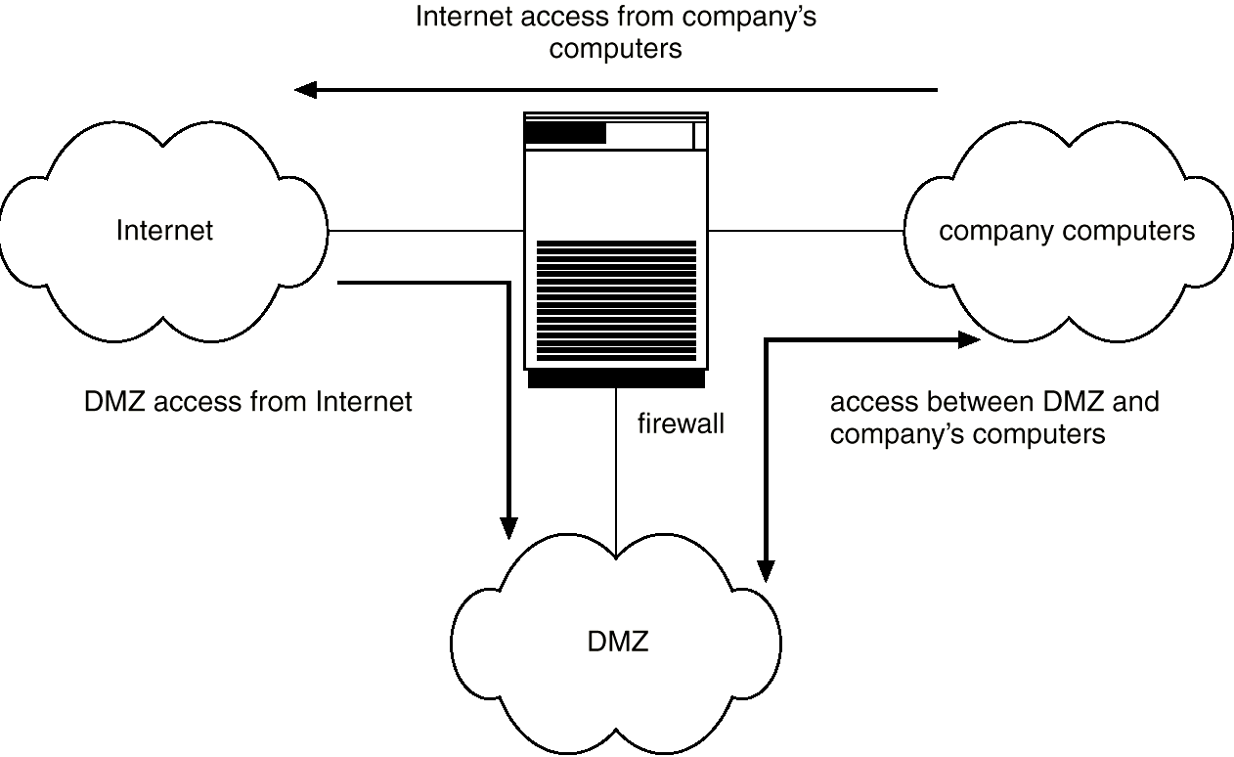
Firewall
A firewall is placed between trusted and untrusted hosts.
The firewall limits network access between these two security domains.
Network Security Through Domain Separation Via Firewall

Slide 25
Encryption
Encryption (to change data/electronic information or signals into a secret code (system of letters, numbers or symbols) that people cannot understand or use on normal equipment)
Encrypt clear text into cipher (code) text.
Properties of good encryption technique:
  Relatively simple for authorized users to encrypt and decrypt data.
  Encryption scheme depends not on the secrecy of the algorithm but on a parameter of the algorithm called the encryption key.
Data Encryption Standard substitutes characters and rearranges their order on the basis of an encryption key provided to authorized users via a secure mechanism. Scheme only as secure as the mechanism.

Slide 26
Encryption (Cont.)
Symmetric-key encryption: same key used for encryption and for decryption
Public-key encryption (a.k.a. asymmentric-key encryption): use different keys for encryption and decryption
  public key – published key used to encrypt data.
  private key – key known only to individual user used to decrypt data.
  Hybrid schemes combining public key and private key encryption for efficient encryption of large amounts of data

Slide 27
Digital Signatures
Digital signatures are used to verify authenticity of data
  E.g., use private key (in reverse) to encrypt data, and anyone can verify authenticity by using public key (in reverse) to decrypt data. Only holder of private key could have created the encrypted data.
  Digital signatures also help ensure nonrepudiation: sender cannot later claim to have not created the data

Slide 28
END

